Slide 1
Write the deck. Don't design it.
Lutrin — a presentation compiler for people with something to say
Lutrin · July 2026

Slide 2
Two kinds of time
Notes:
Open on the cost, not on the tool. Everyone in the room has lost an afternoon to a deck.

Slide 3
Every deck costs you twice
Once to work out what you have to say
Once to nudge the box two pixels to the left
Pick the blue again, off the slide that already had it
Shrink the text until it fits — differently on every slide
Redo all of it when the numbers change on Thursday
Only the first one was ever your job.
Notes:
The second list is deliberately mundane. Recognition is the argument.

Slide 4
You write the content. The engine does the geometry.

Slide 5
How a deck gets made
By hand
By compiler
Duplicate yesterday's slide
Delete its content, keep its boxes
Drag, align, resize, recolour
Discover on the projector that one title wrapped
Write the content in Markdown
Run lutrin build deck.md
Read the diagnostics, if any
Hand over a .pptx anyone can open

Slide 6
The trade
What you get
What you give up
Layouts chosen for you, from what you wrote
The brand applied by construction, not by discipline
A deck that rebuilds itself when the numbers change
Text and figures under version control, diffable
Placing one element at one exact spot
CSS overrides and escape hatches
Art direction on a single slide
Any argument about which blue it was

Slide 7
How it works

Slide 8
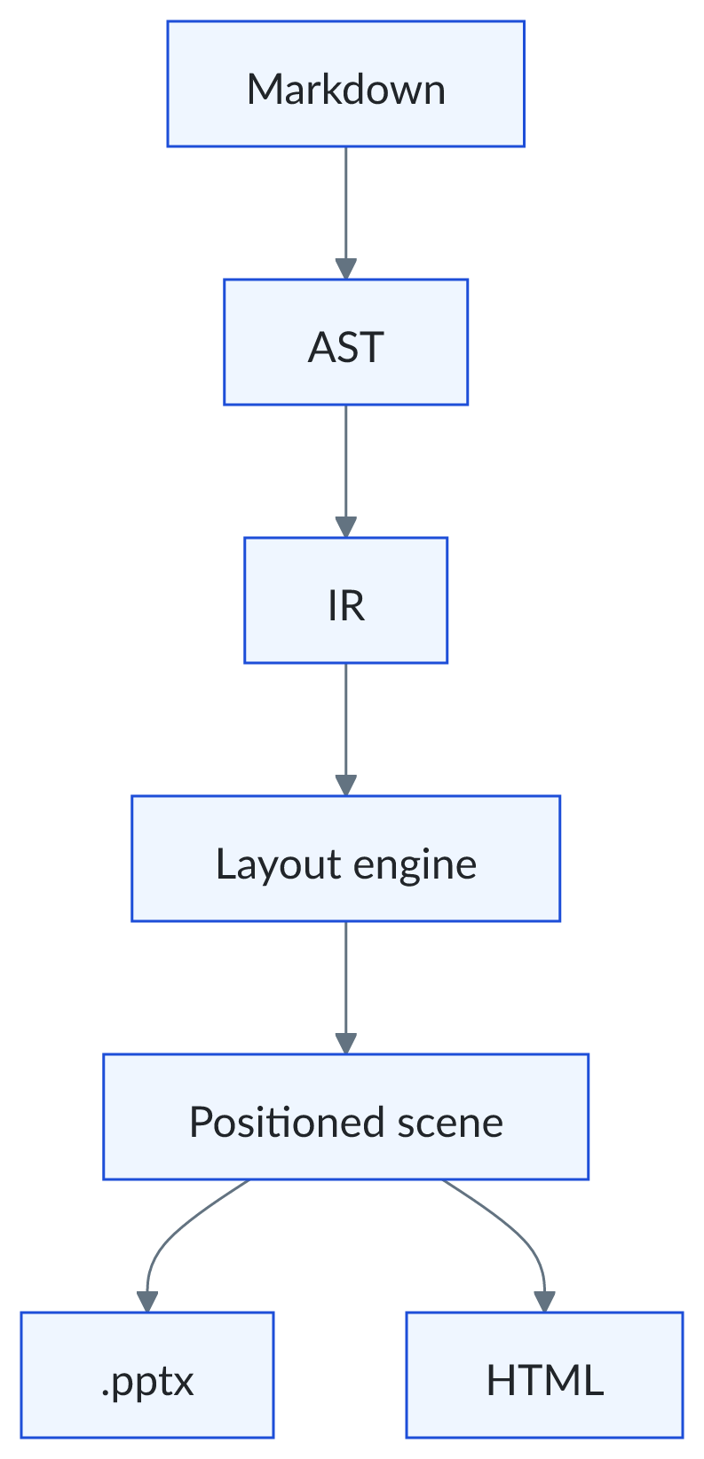
A compiler, in the literal sense
Not a converter with a stylesheet attached. A front end, one intermediate representation, analysis passes, and two renderers that share a single geometry.

Slide 9
The five passes
Parse
Lower
Layout
Scene
Render
Markdown, plus directives, into an AST.
Deck, slides, sections, blocks — source positions kept.
A layout inferred, every block given a slot.
One positioned geometry, in absolute units.
Two outputs from that one scene.
Notes:
Insist on "one scene, two renderers". That is what makes the outputs agree.

Slide 10
Where each piece lives
Outputs
.pptx for PowerPoint and Keynote, one standalone HTML file for the browser.
Renderers
Native shapes, text boxes and tables — or inlined SVG and CSS.
Engine
Layout inference, slot placement, pagination, auto-fit.
Representation
deck → slides → sections → blocks, each carrying its source position.

Slide 11
What you write becomes what you see
You write | The engine draws
# Heading | A new slide, titled
## Section | A slot: column, panel, band or quadrant
- item | A bullet, sized to the room left
:::metric | An indicator card with its trend
```chart | A chart, in the brand's palette
<!-- layout: swot --> | Four quadrants, aligned

Slide 12
One scene, two outputs
PowerPoint
Standalone HTML
Native shapes, real text boxes, real tables. Fonts embedded. The recipient corrects a figure and moves on — no repository to clone, no toolchain to install.
One file, everything inlined. Press <kbd>P</kbd> to present, <kbd>N</kbd> for speaker notes and a timer. Nothing is fetched from the network.

Slide 13
The compiler talks back
Info
SLIDE_PAGINATED — the content did not fit, so it continues on a second slide.
Key point
2/2 remote images — both photographs were fetched and embedded. The deck is self-contained.
Caution
IMAGE_UPSCALED — the image is smaller than the area it fills; it will look soft.
Important
BLOCK_OVERFLOW — already at the densest step, and it still does not fit. Cut something.
Notes:
These four are real diagnostics, quoted verbatim. Forty-odd exist.

Slide 14
What it draws

Slide 15
Indicators
33
15
0
Layouts available
Chart types
Coordinates in this file
↑ +2 this release
↑ +7 this release
→ by design

Slide 16
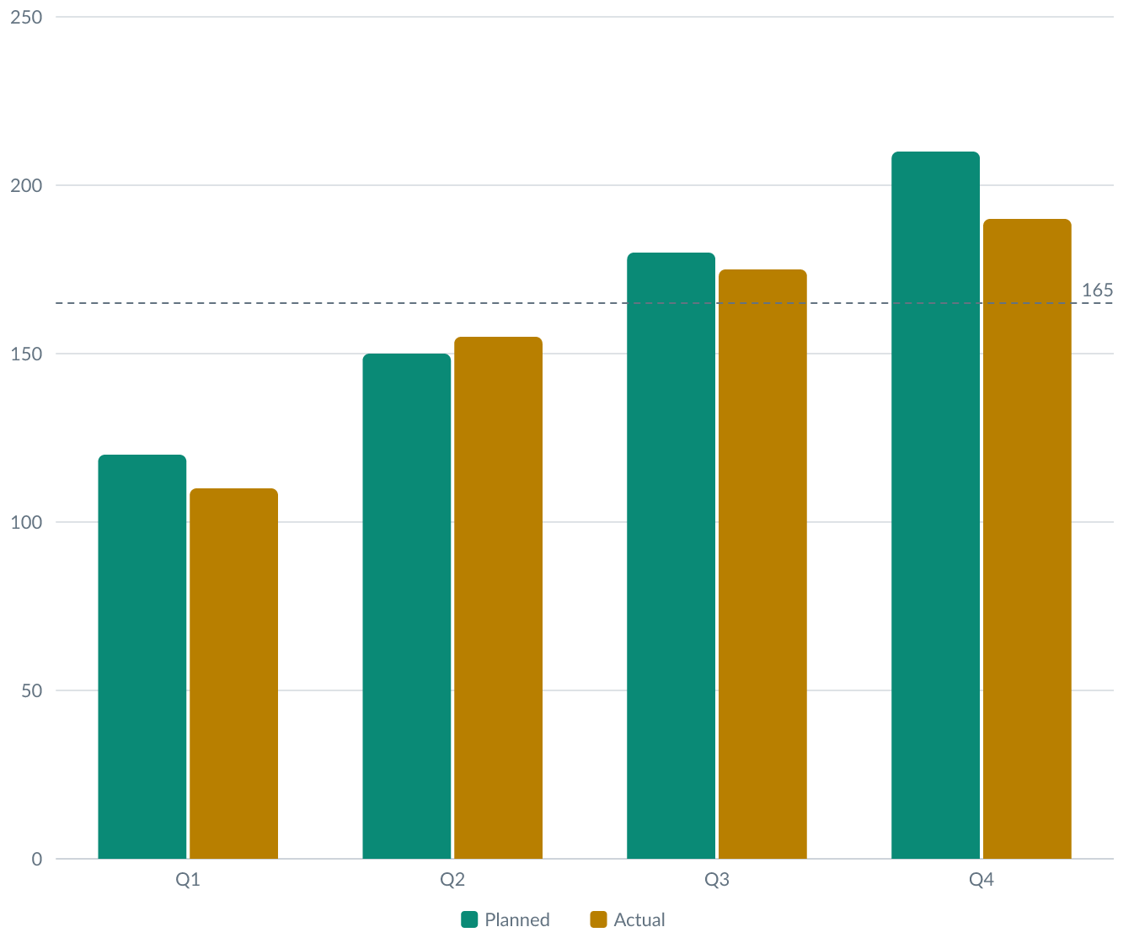
Budget by quarter
The chart is drawn by the engine, in the brand's colours, on a palette checked for contrast and colour blindness.

Slide 17
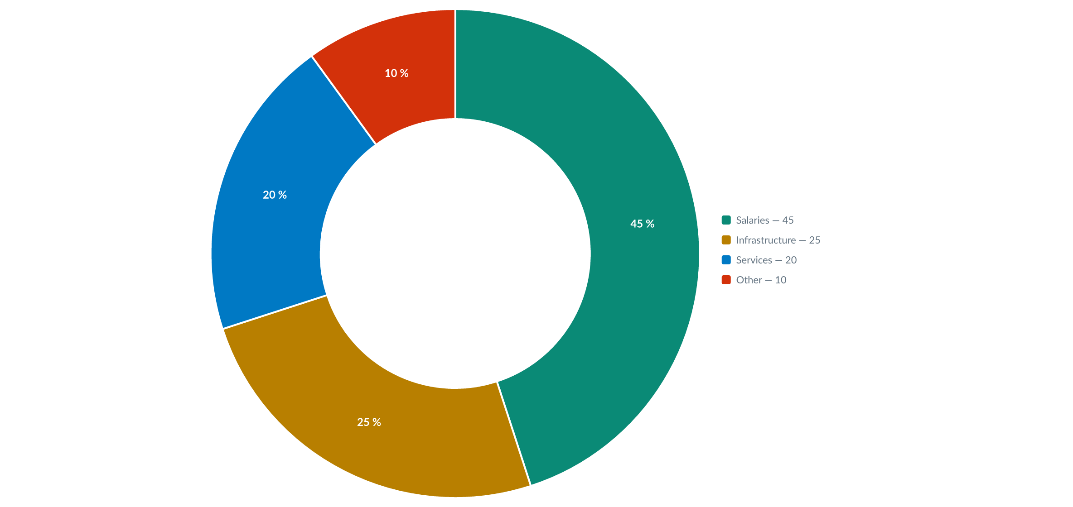
Breakdown of spending

Slide 18
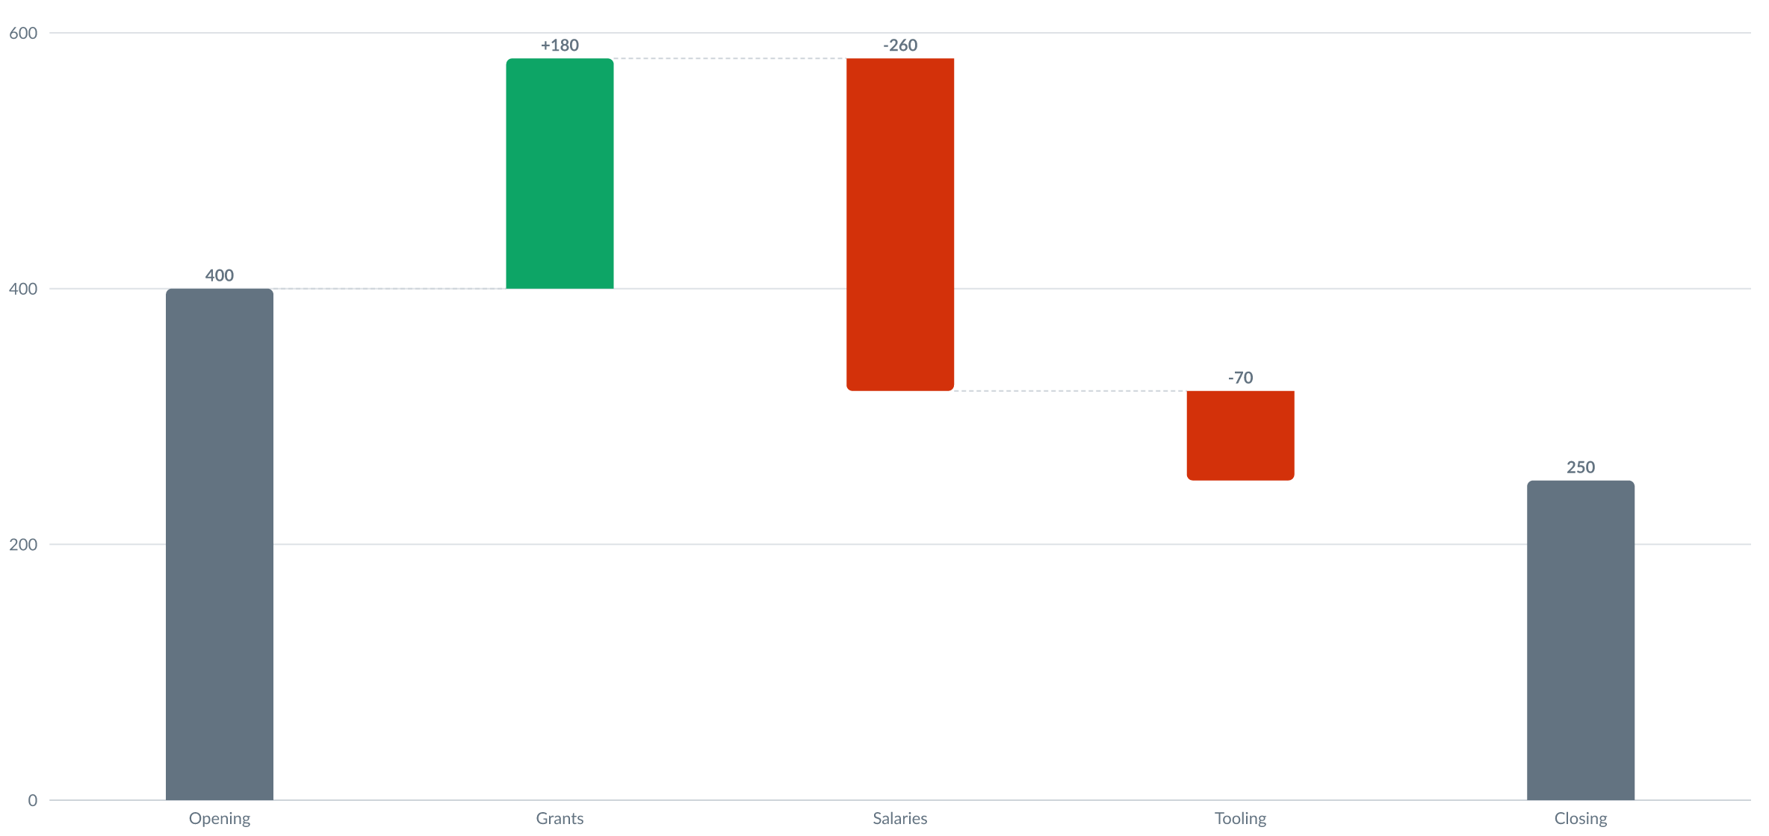
From opening to closing balance

Slide 19
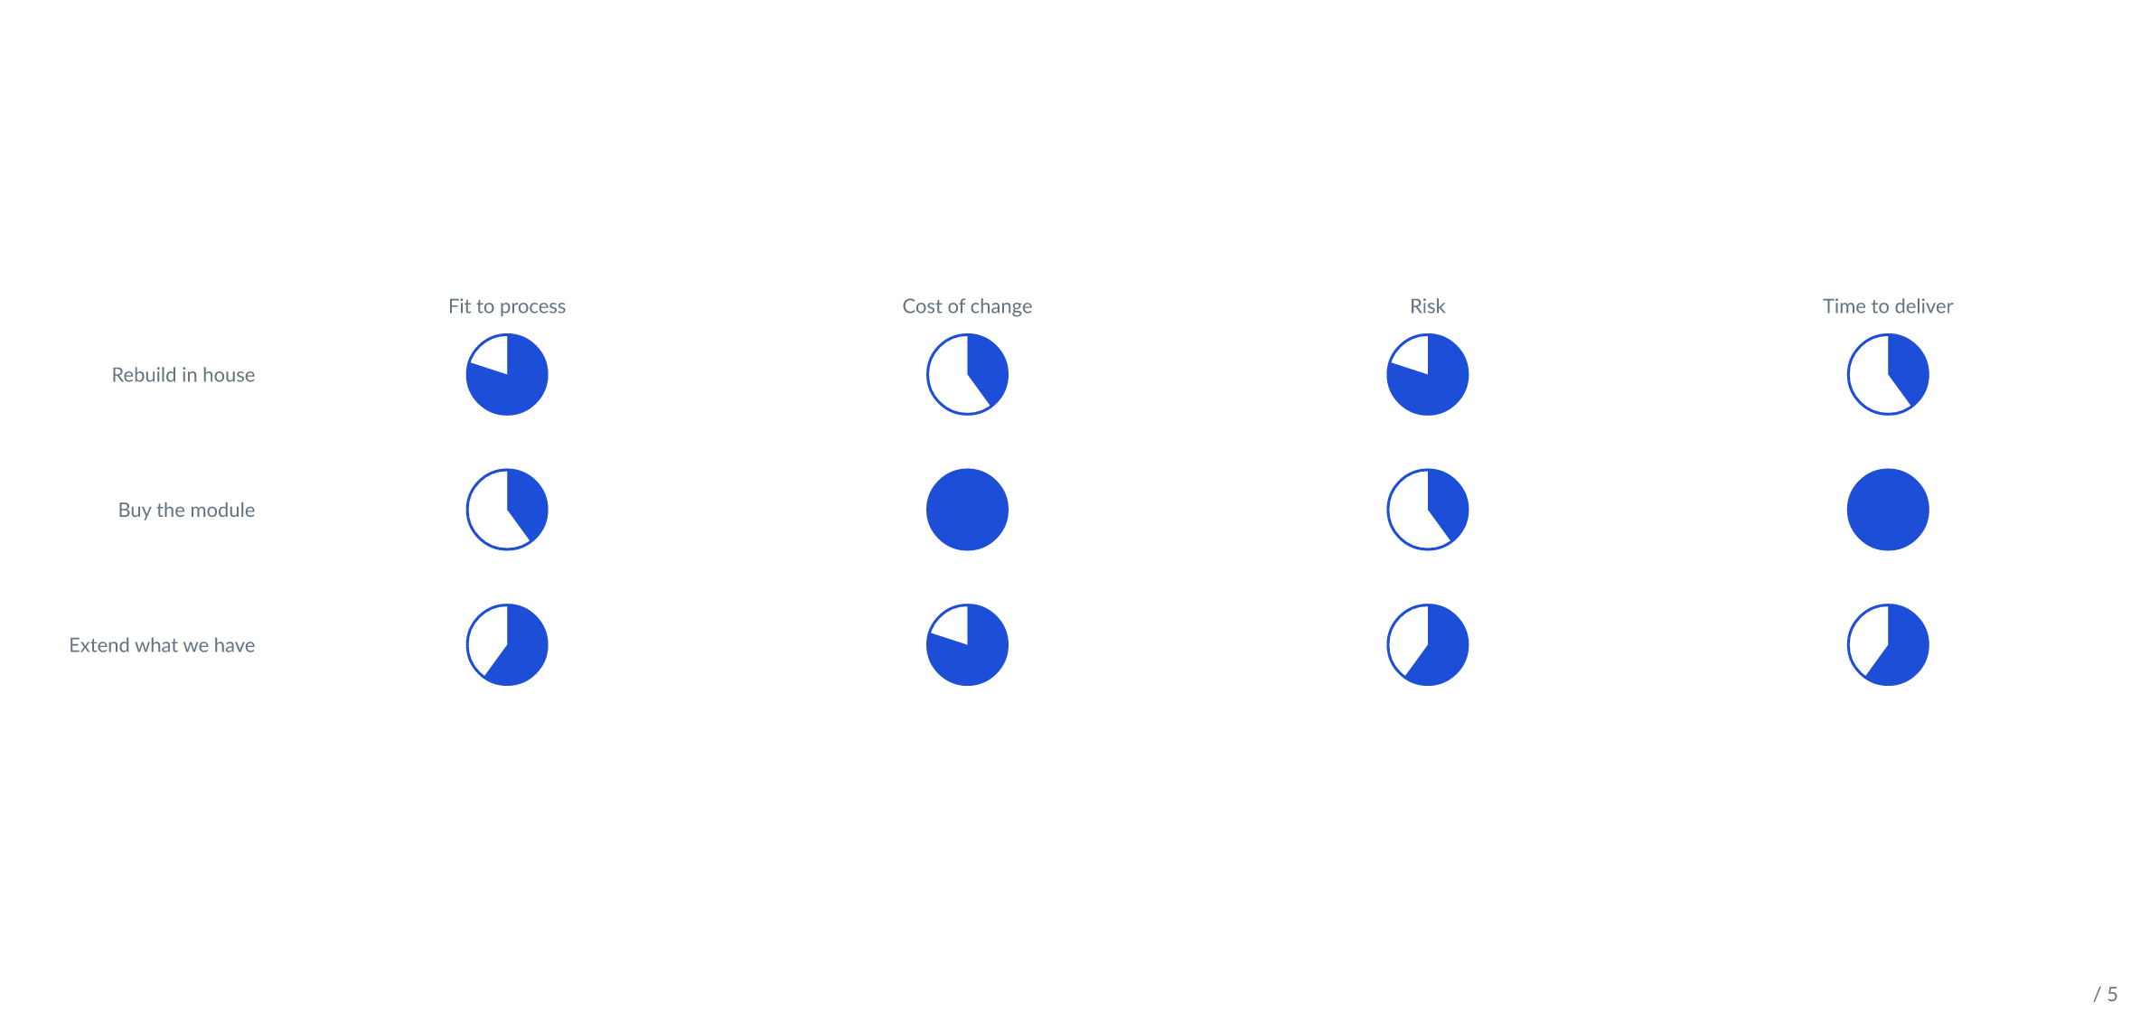
Choosing the platform

Slide 20
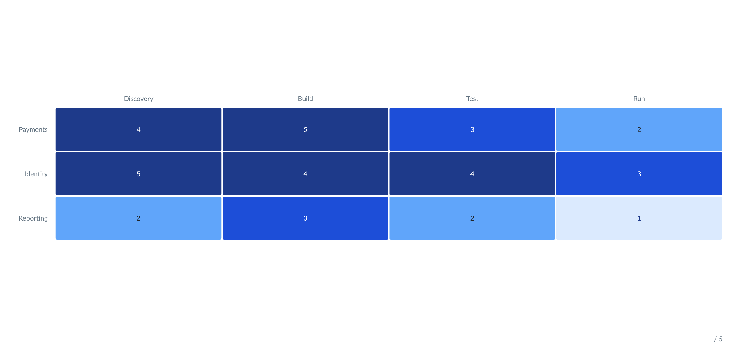
Coverage by team

Slide 21
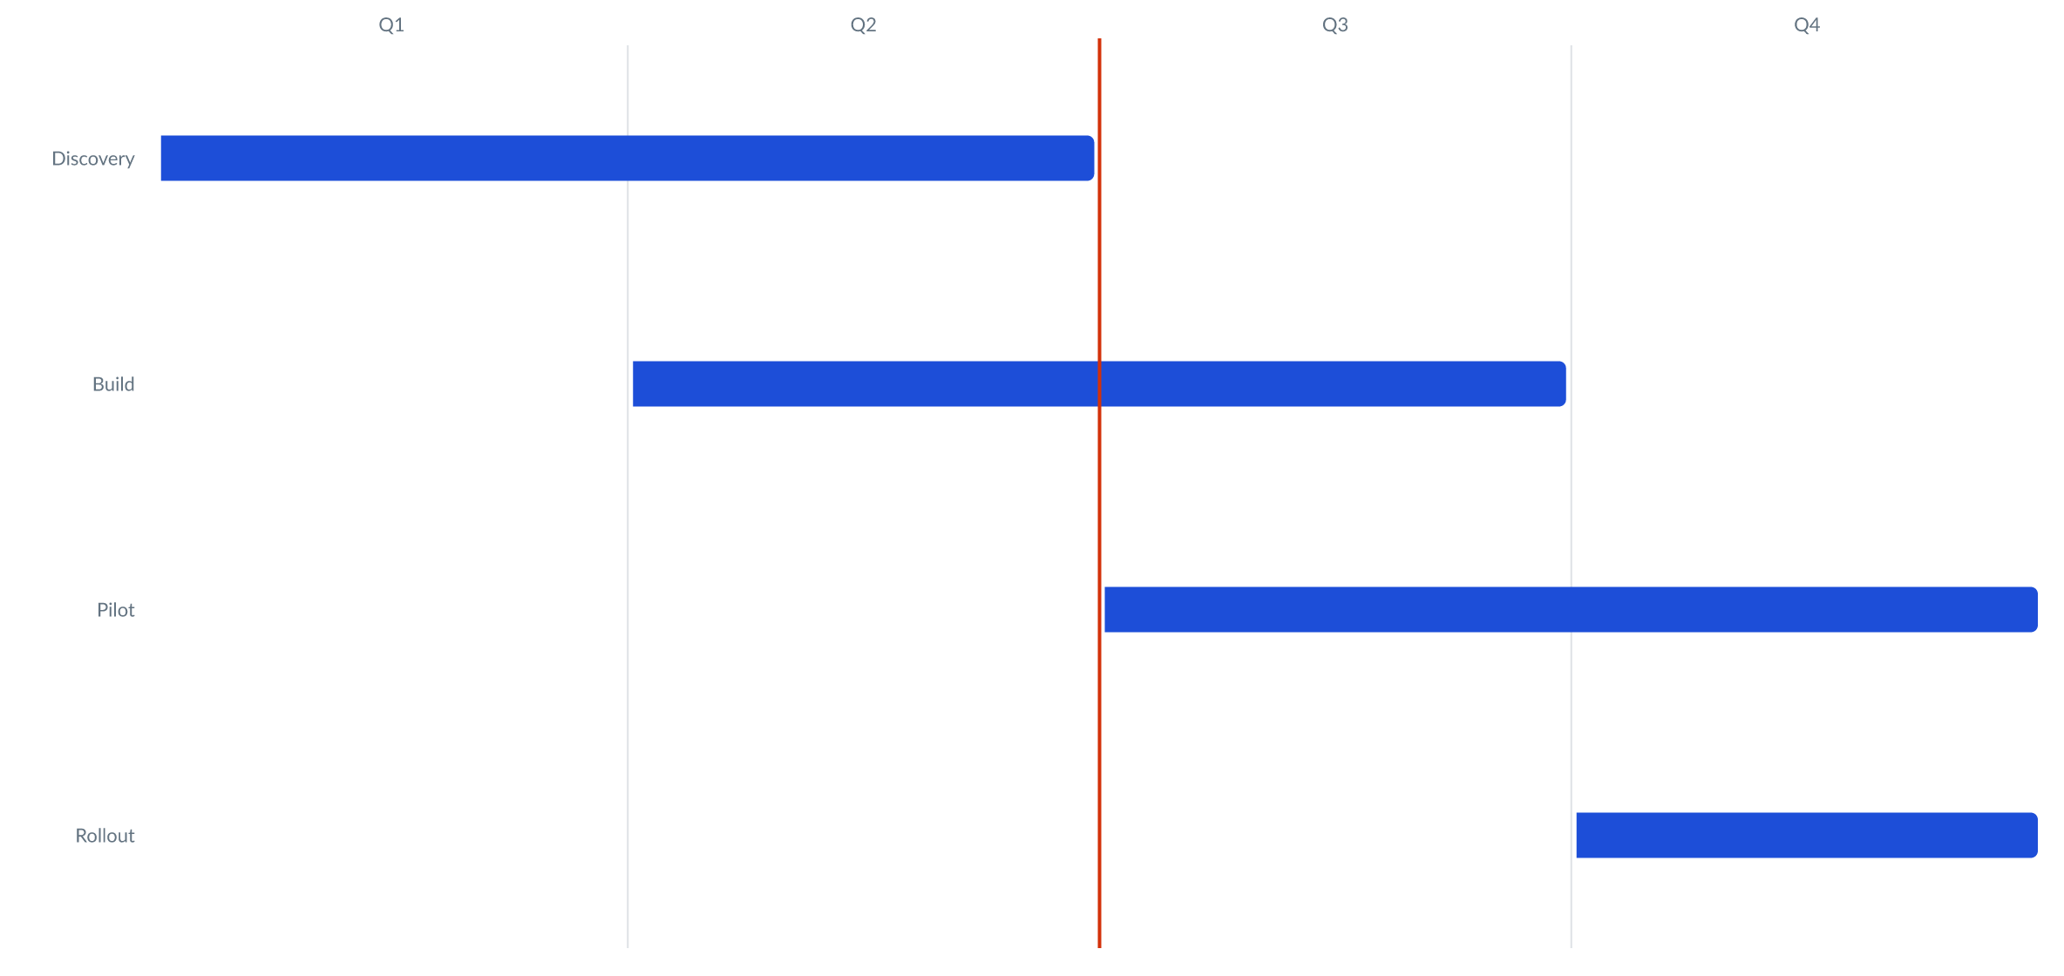
Delivery plan

Slide 22
Where the programme stands
Delivery
Online services
100 %
Delivered in April
Paper forms
45 %
Under analysis, against an 80 % commitment
Commitments
Scope
Schedule
Quality
Budget
Recruitment
Each commitment carries an Owner; one that slips is tagged At risk.

Slide 23
The project at a glance
Strengths
Weaknesses
One source of truth, in version control
The brand applied by construction
No pixel-level control, ever
A DSL to learn, however small
Opportunities
Threats
Decks generated by an agent, then checked
One kit, every deck in the organization
A slide that genuinely needs art direction
Evolution of the OOXML format

Slide 24
Programme log
Risks
Assumptions
Recruitment slipping into the next quarter.
The kit is ready before the pilot starts.
Issues
Dependencies
Two source systems still disagree on totals.
The identity service, delivered by another team.

Slide 25
Effort and impact
Do first
Plan
Automated build in CI.
Kit for the whole organization.
Quick wins
Later
Diagnostics in the editor.
Extra export formats.

Slide 26
Request triage
2,400 received
All channels combined.
1,100 eligible
After checking the criteria.
320 selected
Funded this year.

Slide 27
What holds it up
One deck, on brand
What the audience sees.
Layouts and kits
Chosen by the engine, owned by the organization.
One geometry
Computed once, rendered twice.

Slide 28
Roadmap
1
Q3 2026
Widgets for status boards and scorecards.
2
Q4 2026
Kit editor, and images addressed by name.
3
Q1 2027
Incremental builds and a visual regression suite.

Slide 29



Three reasons it holds
Speed
Consistency
Traceability
A deck is a file. Change a figure, rebuild, hand it over.
The brand is in the kit, not in your muscle memory.
Diffable, reviewable, and rebuilt by CI like any other artefact.

Slide 30
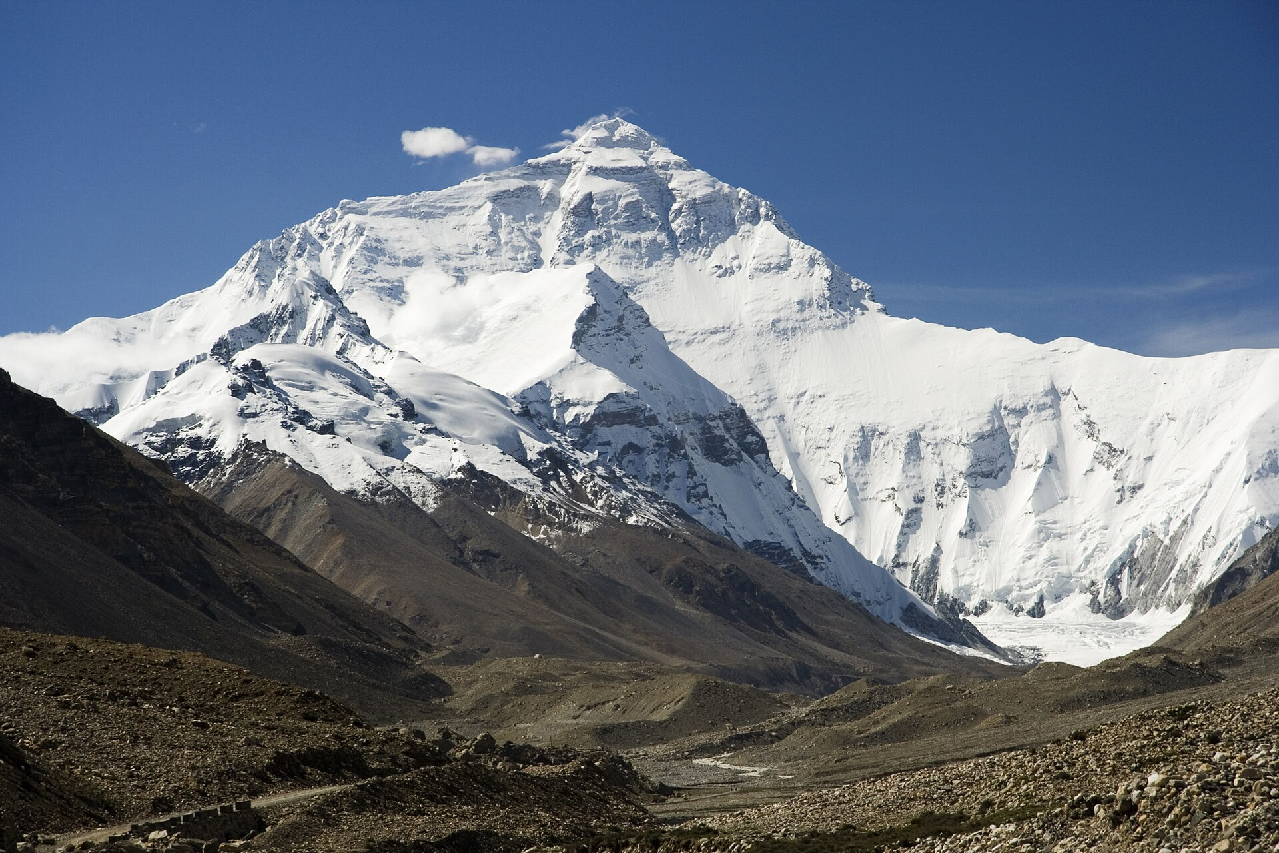
On images
A local file, or a URL fetched at build time
With assets: vendor, a copy is kept next to the deck
The result is self-contained: no live network, ever
Under-resolution is measured and reported, not discovered on the projector
Photo © Luca Galuzzi — Wikimedia Commons, CC BY-SA 2.5

Slide 31
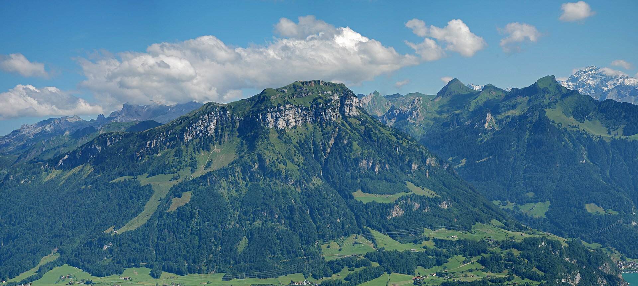
A photograph fills the frame
Photo © Hannes Röst — Wikimedia Commons, CC BY-SA 3.0
Made with Lutrin

Slide 32
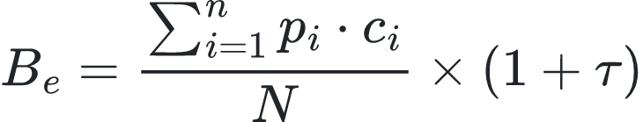
The allocation formula
The budget allocated to each team is computed as follows:
where p is the workload, c the priority coefficient and τ the annual indexation rate.

Slide 33
The code stays readable
export function pickLayout(slide: Slide): LayoutName {
if (slide.blocks.every(isMetric)) return 'metrics';
if (slide.sections.length === 4) return 'swot';
if (slide.blocks.some(isChart)) return 'chart';
return 'content';
}

Slide 34
A brand fits in a manifest
{
"name": "acme",
"colors": { "primary": "#0F766E", "accent": "#B45309" },
"fonts": { "heading": "Acme Grotesk", "body": "Acme Text" },
"logo": "./logo/acme.svg"
}

Slide 35
One point at a time — press → to reveal
A deck can hold its points back and release them one by one
One line in the file, <!-- animate -->, and every block becomes a step
The .pptx gets real PowerPoint animations, not a stack of duplicated slides
Which is why this slide looks empty until you press the arrow
Notes:
This slide is deliberately empty until the first click. That is what `<!-- animate

Slide 36
A word from the people who use it
“
I stopped opening PowerPoint to make a deck. I open it to read the one the build gave me.
— A programme lead, after the third rebuild in one week

Slide 37
Start in one line
npx lutrin build deck.md -o deck.pptx
Node 22 or later. Nothing else to install. MIT.
Notes:
Hand out the URL here. The .pptx of this very deck is on the site.

